Slide 1

IMPLEMENTING A SMART TRAFFIC LIGHT SYSTEM USING REAL TIME TRAFFIC DENSITY.
GROUP 18.

Slide 2
GROUP MEMBERS.
NAME(S) | INDEX NUMBERS
OWUSU STEPHEN | 1859422
POBI KWAKU GABRIEL | 1859722
BRYAN QUARSHIE | 1859922
STEPHANY OSEI BONSU | 1859122
SENA QUIST LYNN | 1860022
OWUSU CHIEF | 1859222
QUAGRAINE HERBERT | 1859822
DANIEL OWUSU-AMPONSAH | 1859622
OWUSU PRINCE OTHNIEL | 1859322

Slide 3
TABLE OF CONTENTS
Problem Statement
Methodology
Demonstration/Simulation
Conclusion

Slide 4
PROBLEM STATEMENT.
Congestion of vehicles in cities is a debilitating issue causing frustration for drivers and pedestrians. To curb this problem, This project is solely based on developing a smart traffic light system that not only frequently adjust the traffic lightning in various lanes to allow and disallow cars in and out of an intersection but uses the amount of cars in various lanes as a parameter for adjusting the traffic lightning.

Slide 5
METHODOLOGY.
The road model used was a crossroad.
System Design and Planning
Before implementing the system, we planned the entire circuit and how components would interact. The key considerations included: The number of lanes to be controlled (4 lanes).The type of sensors to detect vehicles (ultrasonic sensors).The traffic light sequence and timing adjustments based on congestion. The microcontroller to be used (Arduino mega).
Hardware Components and Circuit Design: The circuit consists of:Ultrasonic Sensors (HC-SR04) for each lane, Traffic Light LEDs implemented with red, yellow and green LEDs and finally the Arduino mega.

Slide 6
Methodology
Connections: The trigger pins of the ultrasonic sensors are connected to digital pins on the Arduino. The echo pins receive signals and are also connected to Arduino inputs. The traffic lights (LEDs) are connected to output pins of the Arduino, which control their on/off states. The circuit was designed in Wokwi (a simulation tool), allowing us to test functionality before physically assembling the hardware.
Sensor Data Collection & Processing: The Arduino sends a trigger pulse to the ultrasonic sensor. The sensor emits ultrasonic waves that bounce off vehicles and return. The echo pin receives the signal, and the Arduino calculates the distance based on time taken. If the distance is less than 50 cm (threshold value), a vehicle is considered present. The system maintains a vehicle count for each lane, updating congestion levels dynamically.

Slide 7
Methodology
Traffic Light Control Logic: The system prioritizes the lane with the highest number of detected vehicles. The traffic light control follows these steps:All lanes start with red lights to ensure safety. The Arduino identifies the most congested lane. That lane receives a green signal for a dynamic duration, calculated as: Green Time=Base Green Time+(Number of Vehicles×Extra Time per Vehicle)Green Time=Base Green Time+(Number of Vehicles×Extra Time per Vehicle)The time is capped at a maximum of 20 seconds to prevent long waiting times in other lanes. After the green phase, the yellow light activates for 3 seconds before turning red. The process repeats for the next most congested lane.

Slide 8
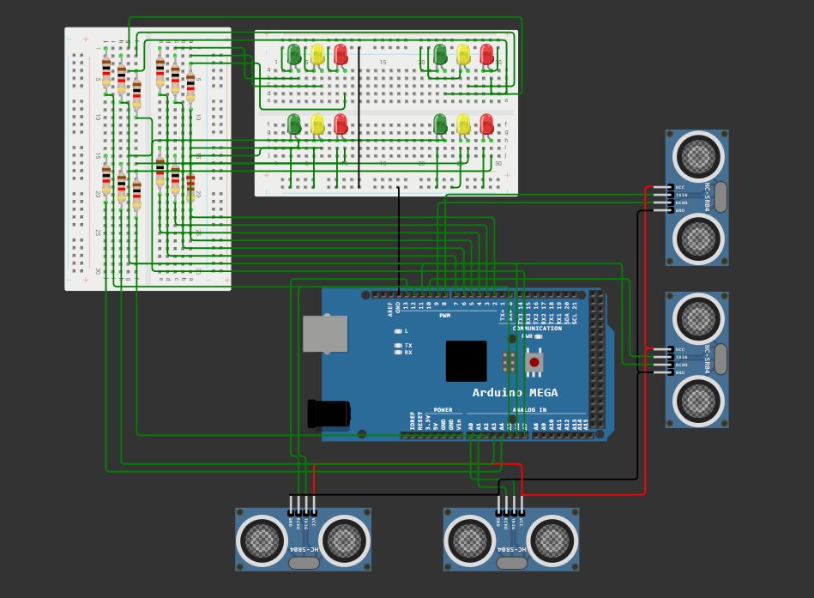
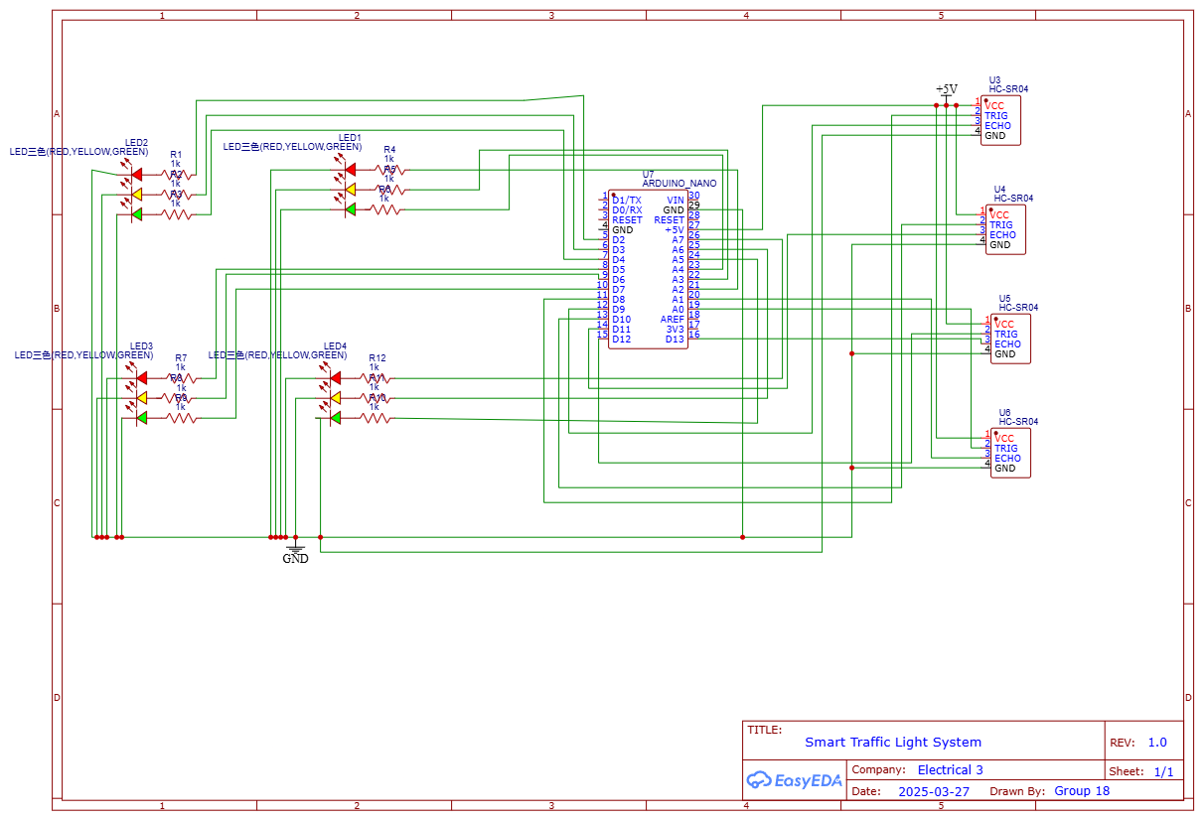
CIRCUIT/SCHEMATIC

Slide 9
CONCLUSION.
Challenges:
Using tinker cad did not provide the opportunity to model a road for the project. We then used Proteus to rectify this issue and then we encountered an issue with the libraries on Proteus.
The Arduino Uno board could not meet the peripheral needs of the project and hence an Arduino mega board was used instead which was provided by wokWii.
Future Improvements:
Use of AI cameras instead of the Ultrasonic Sensors.
Emergency vehicle detection to give priority to ambulances.
A mobile app that tells drivers which roads are less busy and also factors in the number of pedestrians crossing.

